Slide 1
Scholar Management Application
Presented By
A. Akhil.
Y. Surya Prakash.
M. Ishwarya.
P. Vaishnavi.

Slide 2
Contents
Test Plan
Reference Document
Console Project
Automation Project

Slide 3
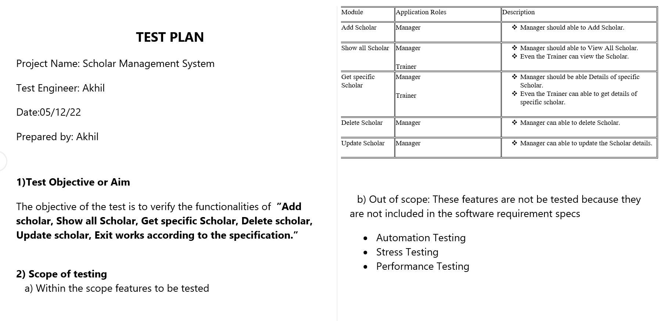
Test Plan

Slide 4
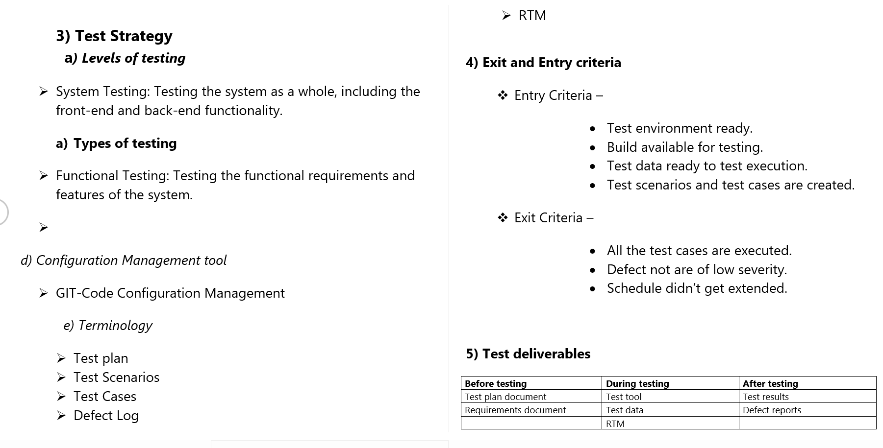

Slide 5
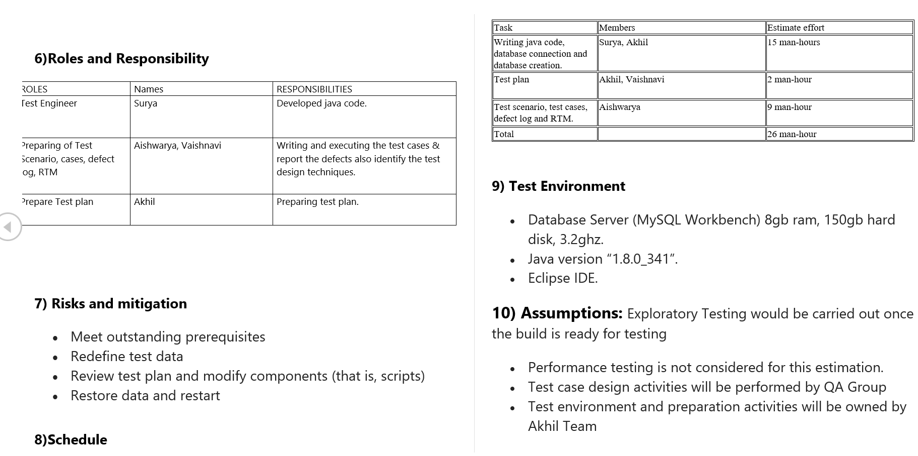

Slide 6
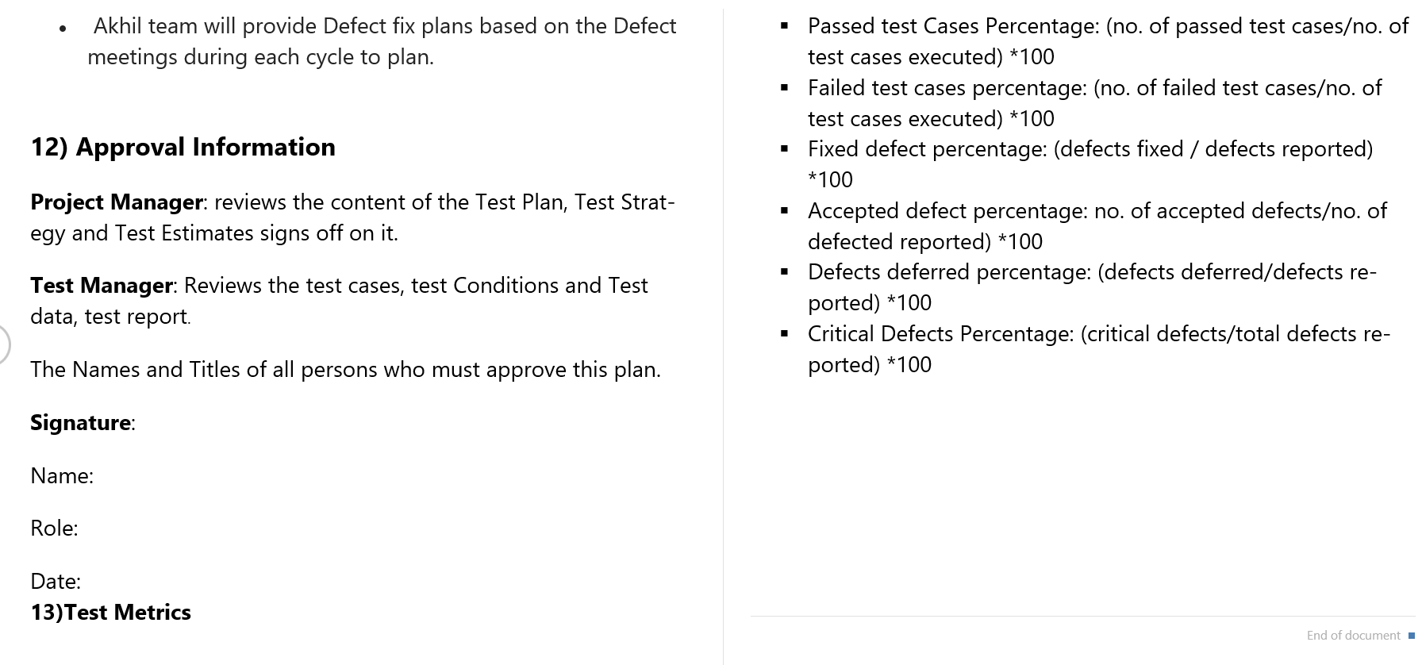

Slide 7
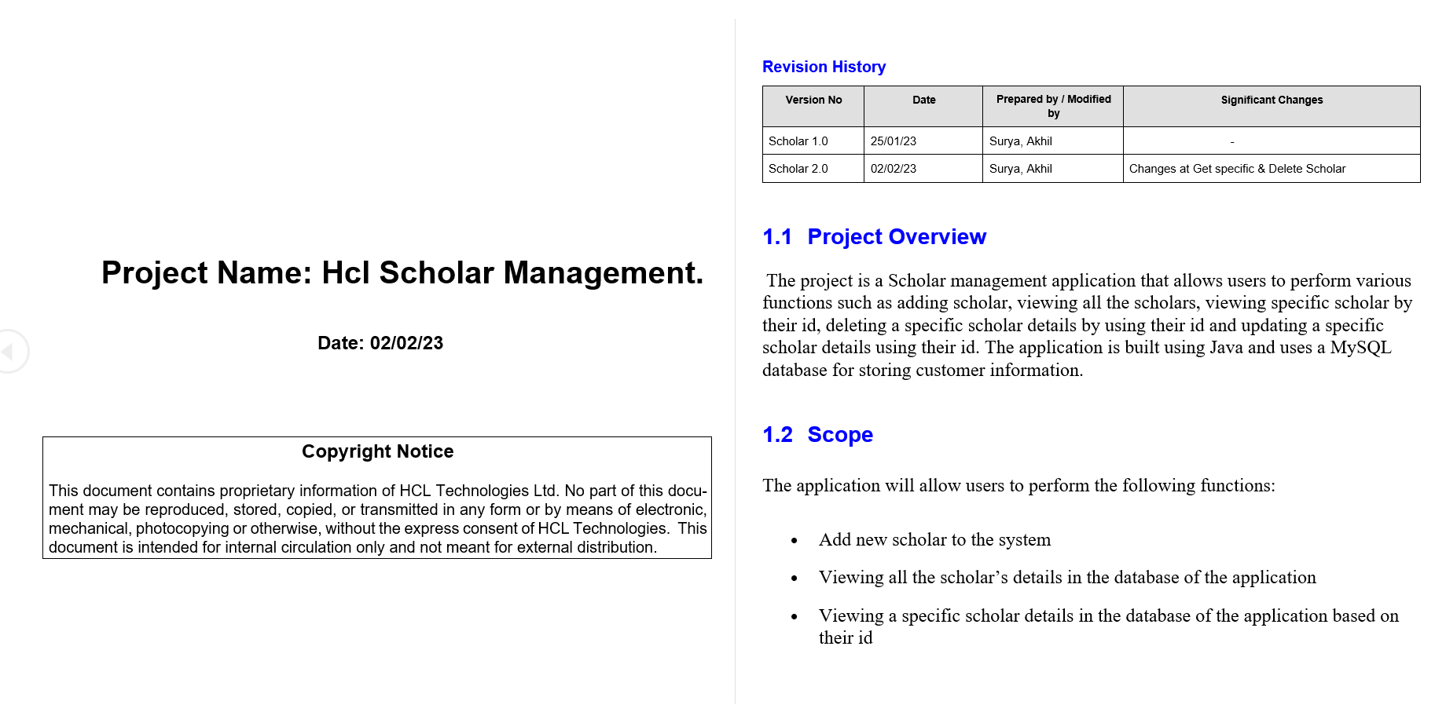
Reference Document

Slide 8
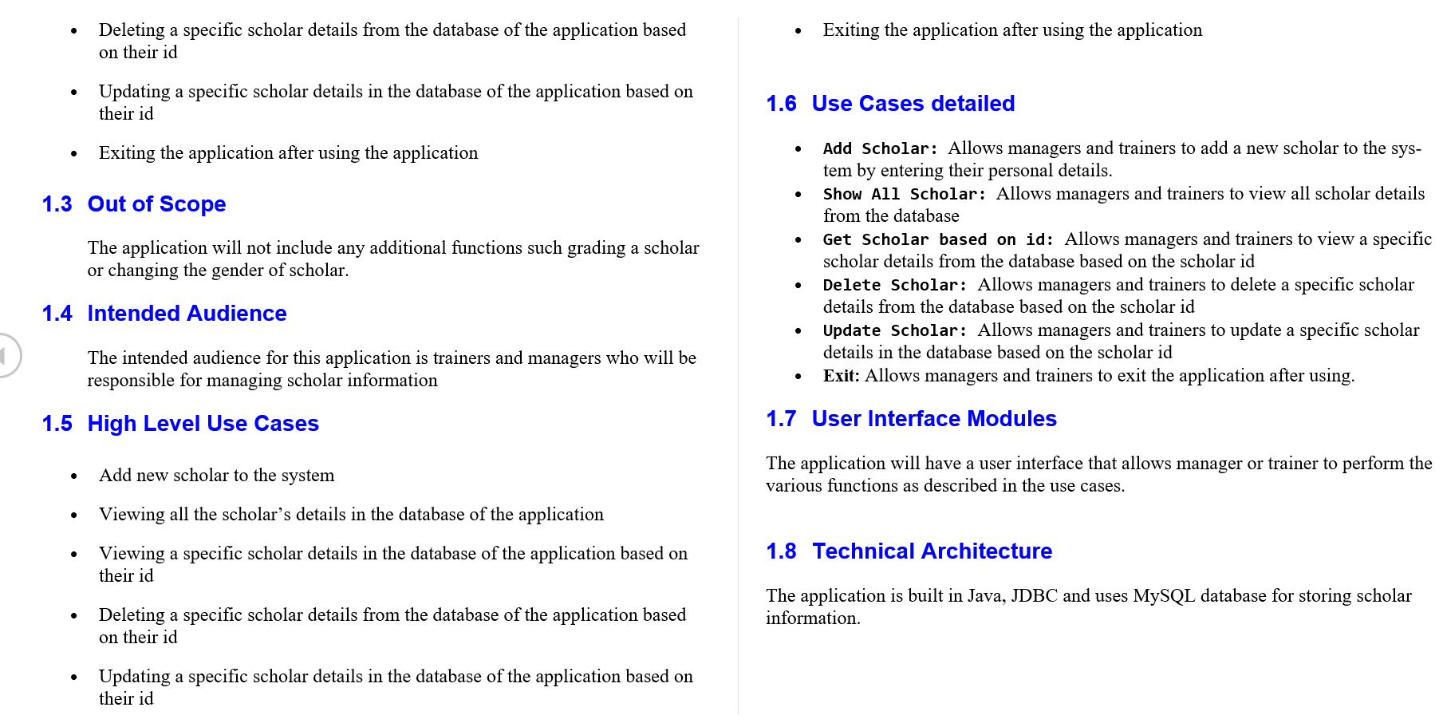

Slide 9
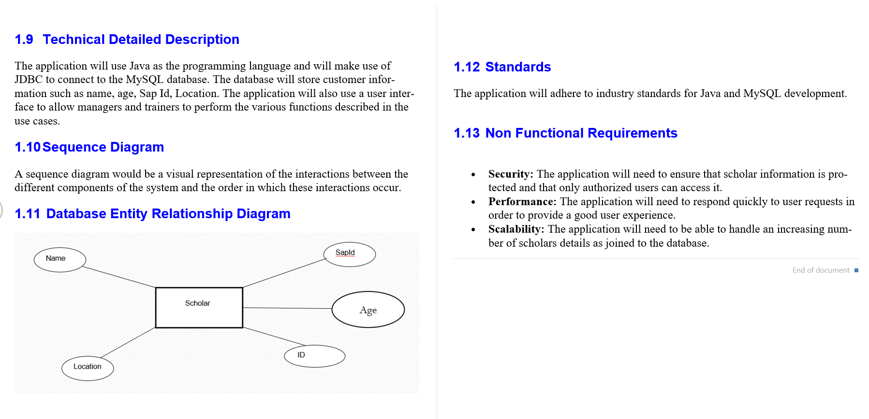

Slide 10
Project Overview
Scholar Management Application consists of Modules-Add Scholar, show all Scholar, Get the Scholar based on the Id, Delete Scholar, Update Scholar and Exit. Each module runs accordingly as the user want to function the application.
This application helps the user to make the list of scholars including their details in the database and they will be able to recollect details as required for them and store them Successfully. Maintenance of the application is too easy.

Slide 11
Modules in Scholar Management
Adding the Scholar in Application.
Showing all Scholar of Application.
Getting Scholar by their Identity.
Deletion of Scholar details.
Updating the Scholar details.

Slide 12
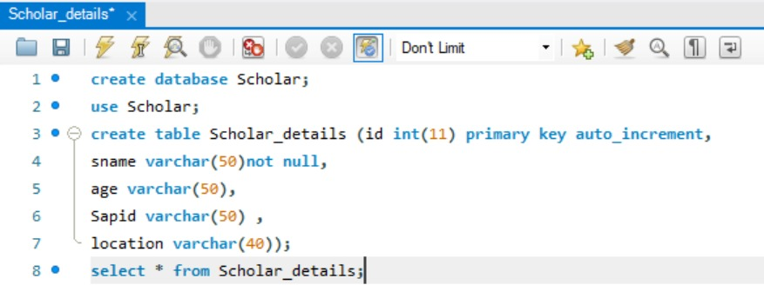
Application Database

Slide 13
Database Entity Diagram
Name
SapId
Scholar
Age
ID
Location

Slide 14
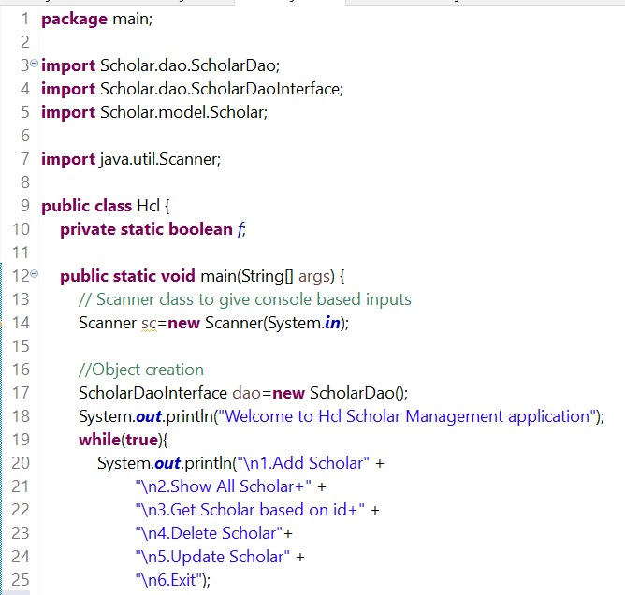
Source Code : HCL.java

Slide 15
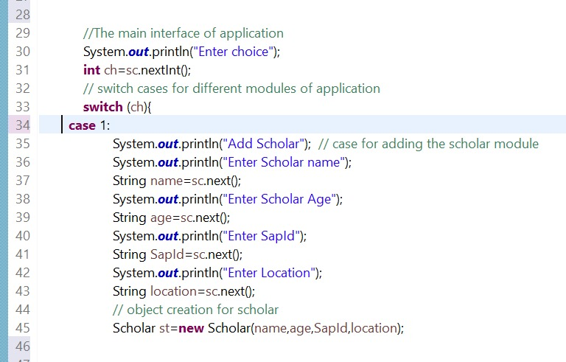
Source Code : HCL.java

Slide 16
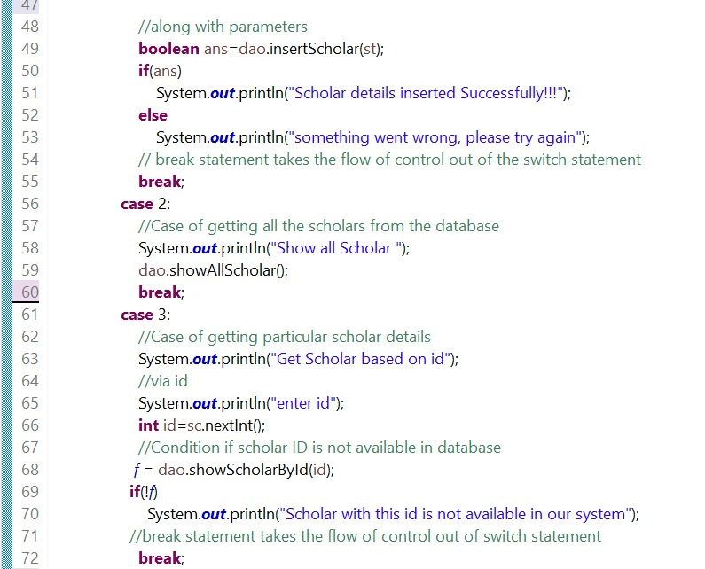
Source Code : HCL.java

Slide 17
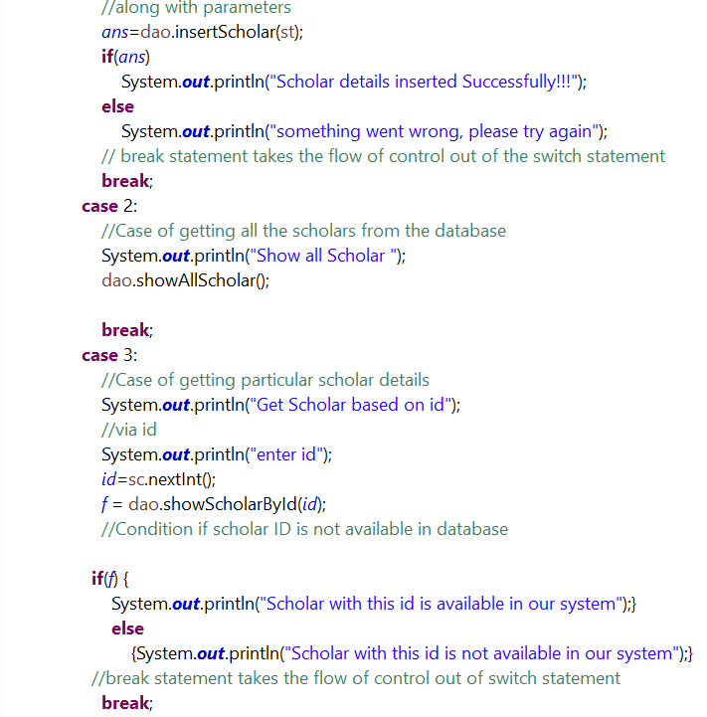
Source Code : HCL.java Version 2.0

Slide 18
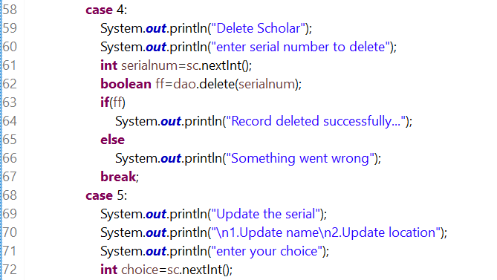
Source Code : HCL.java

Slide 19
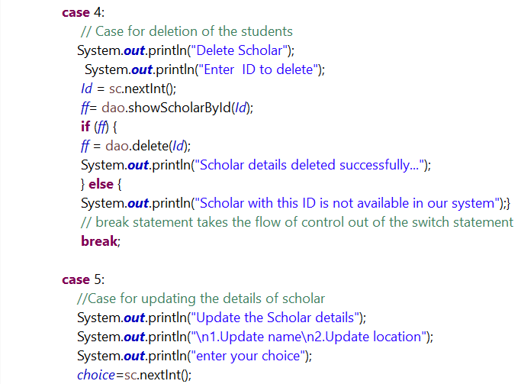
Source Code : HCL.java Version 2.0

Slide 20
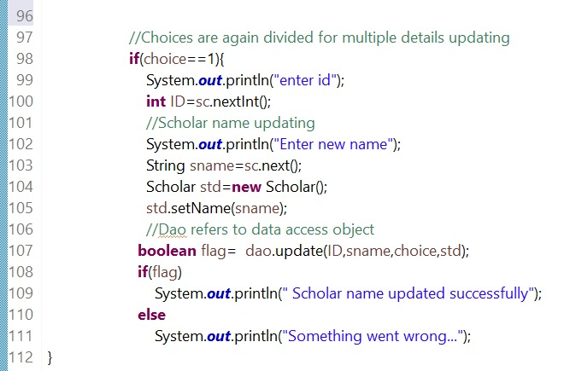
Source Code : HCL.java

Slide 21
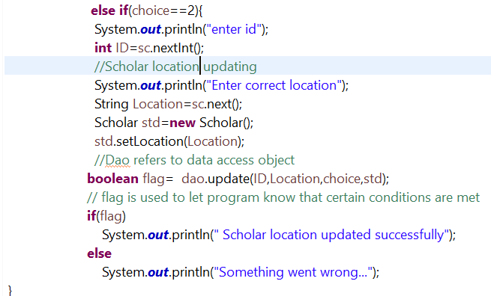
Source Code : HCL.java

Slide 22
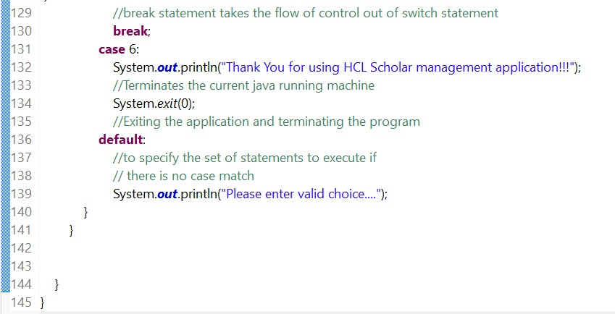
Source Code : HCL.java

Slide 23
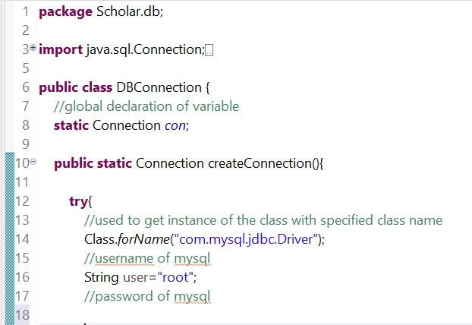
Source Code : DBConnection.java

Slide 24
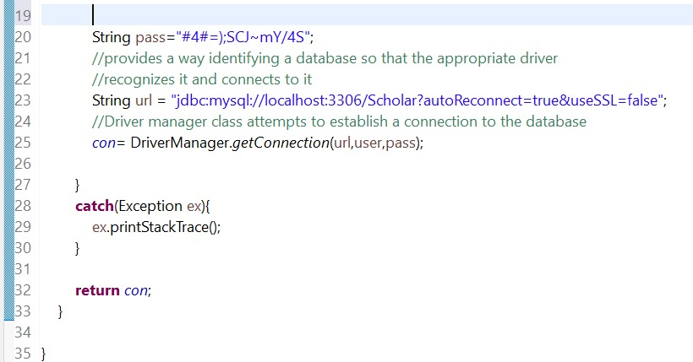
Source Code : DBConnection.java

Slide 25
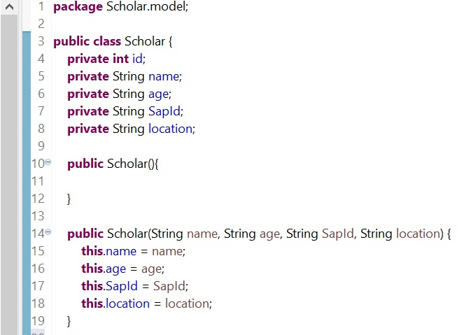
Source Code : Scholar.java

Slide 26
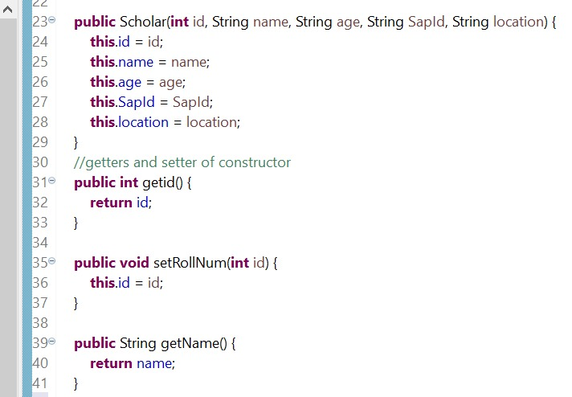
Source Code : Scholar.java

Slide 27
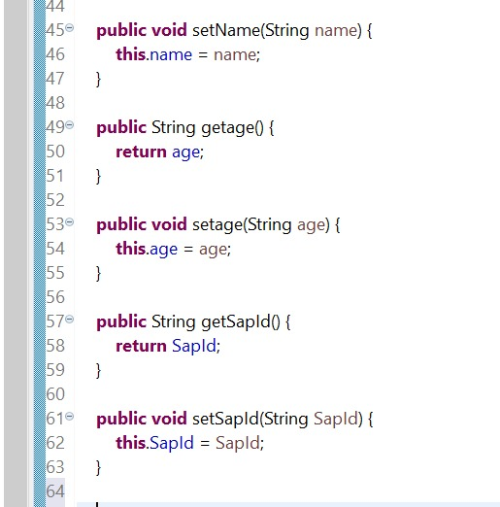
Source Code : Scholar.java

Slide 28
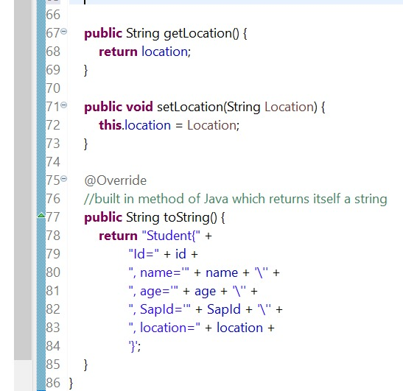
Source Code : Scholar.java

Slide 29
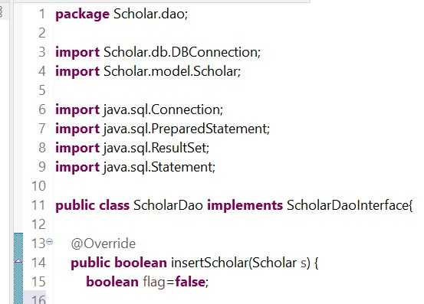
Source Code : ScholarDao.java

Slide 30
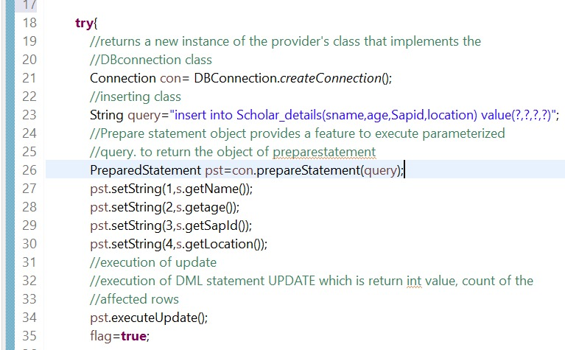
Source Code : ScholarDao.java

Slide 31
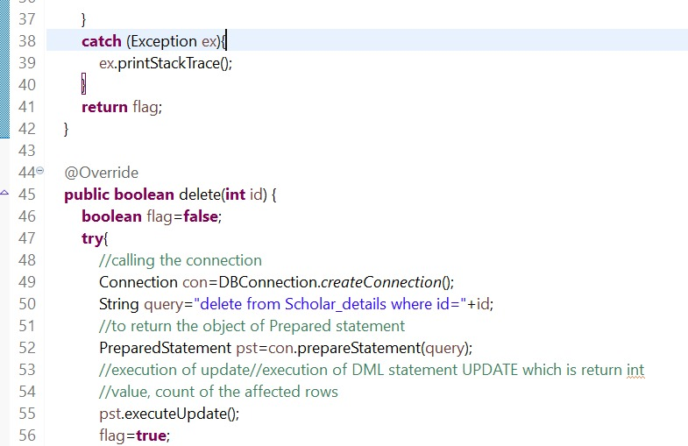
Source Code : ScholarDao.java

Slide 32
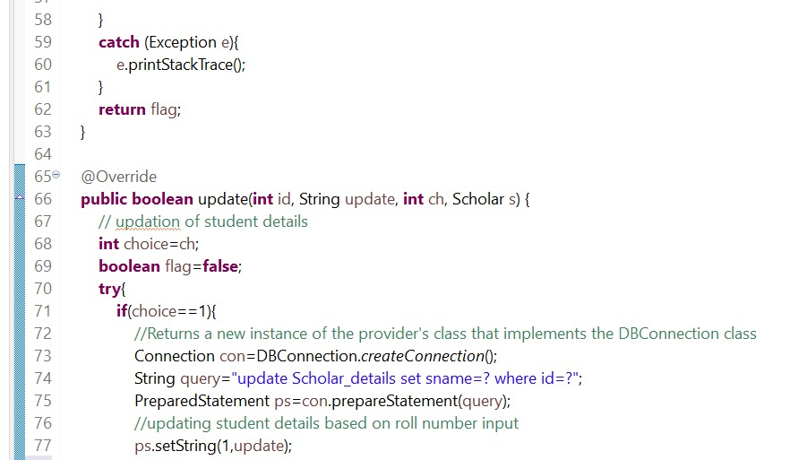
Source Code : ScholarDao.java

Slide 33
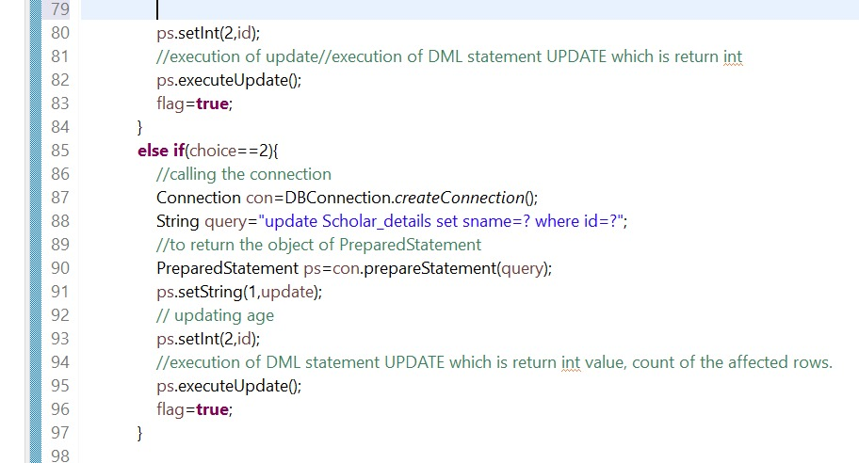
Source Code : ScholarDao.java

Slide 34
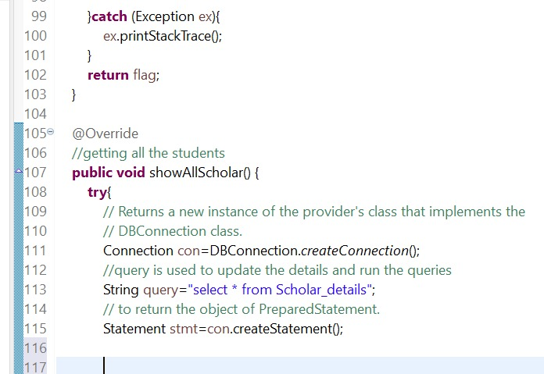
Source Code : ScholarDao.java

Slide 35
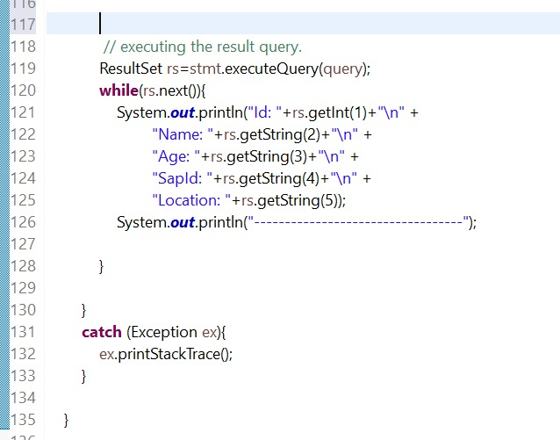
Source Code : ScholarDao.java

Slide 36
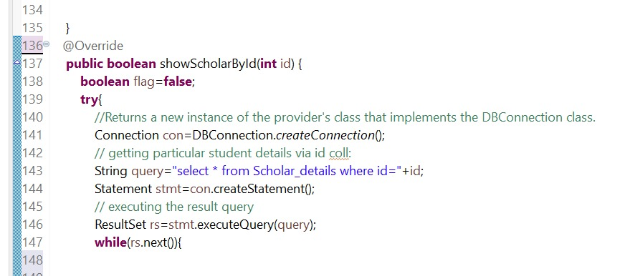
Source Code : ScholarDao.java

Slide 37
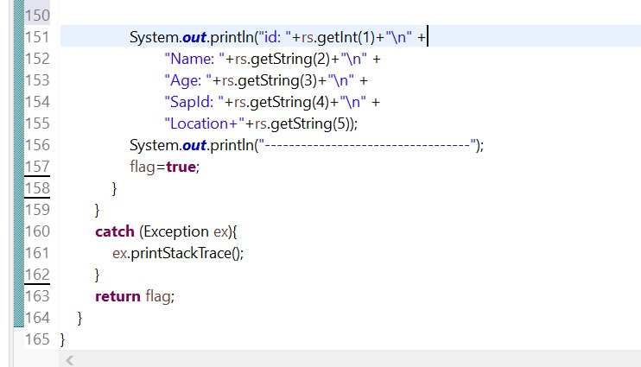
Source Code : ScholarDao.java

Slide 38
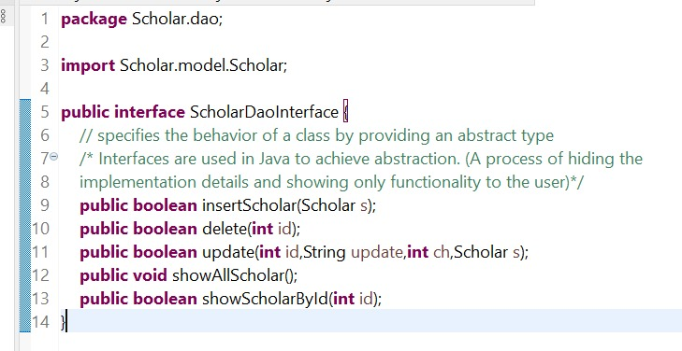
Source Code : ScholarDaoInterface.java

Slide 39
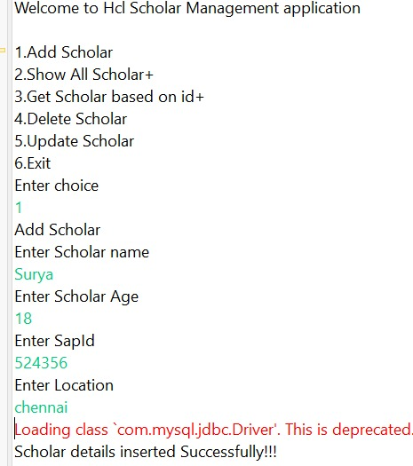
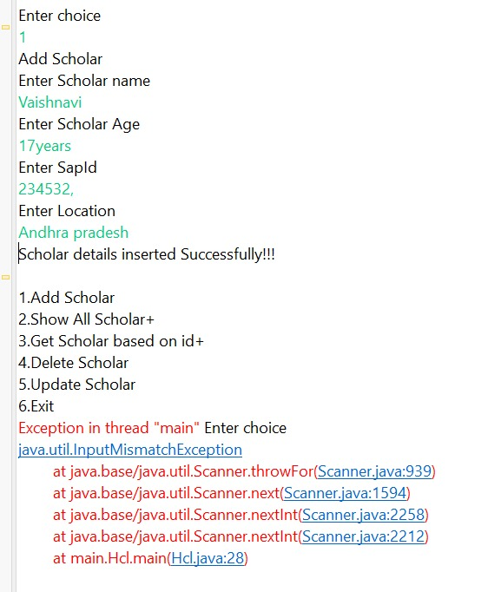
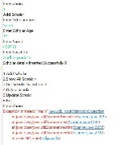
Console View: Adding Scholar
Entering Valid Details of module:
Entering Invalid choice of module:

Slide 40
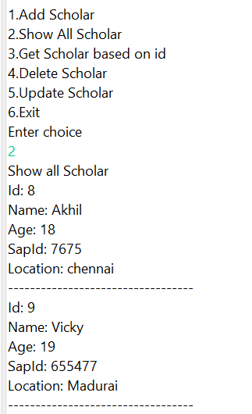
Console View: Show All Scholars
All scholars details are shown

Slide 41
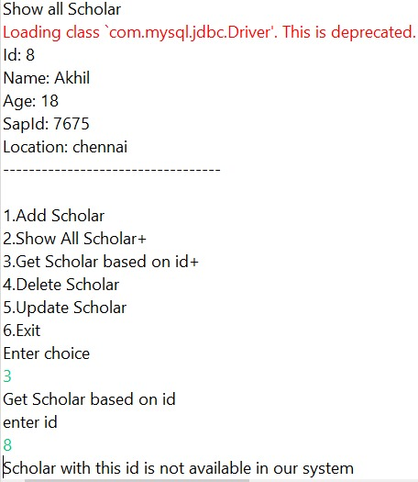
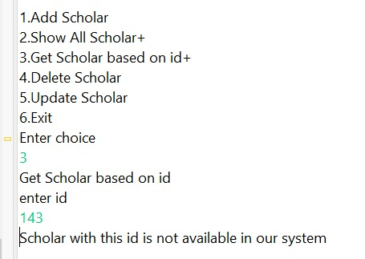
Console View: Get Scholar based on Id
Entering Valid id :
Entering Invalid id:

Slide 42
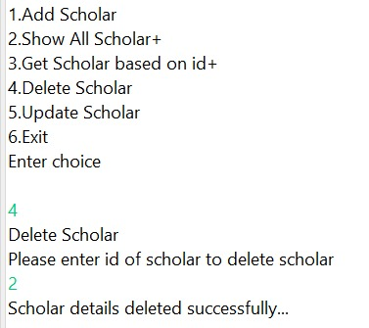
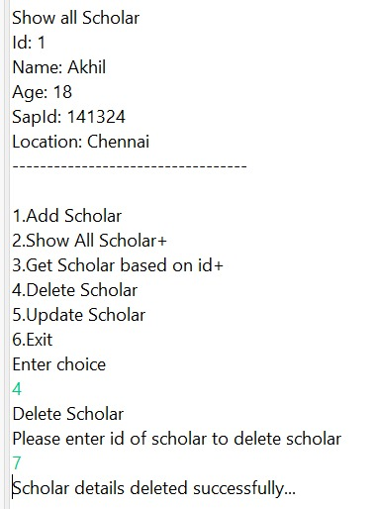
Console View: Delete Scholar based on Id
Deleting scholar by valid id :
Deleting scholar by Invalid id :

Slide 43
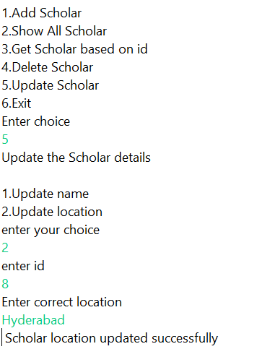
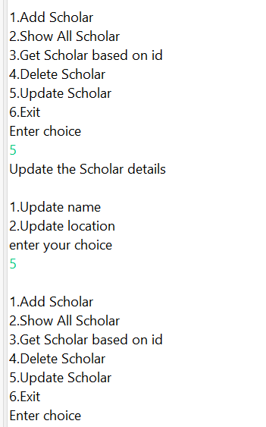
Console View: Update Scholar based on Id
Updating scholar by Valid choice:
Updating scholar by Invalid choice:

Slide 44
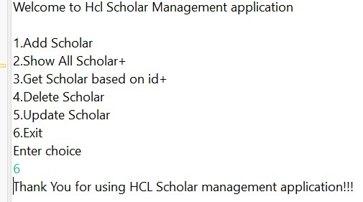
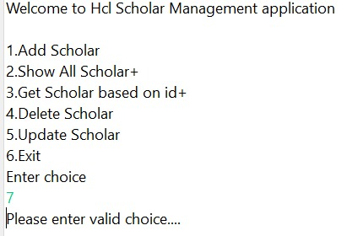
Console View: Exit
Exit Command by Valid choice:
Exit Command by Invalid choice:

Slide 45
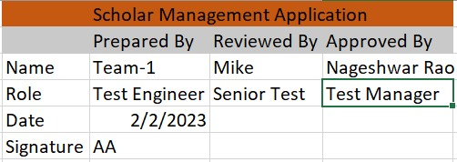
Excel View of Cover Page

Slide 46
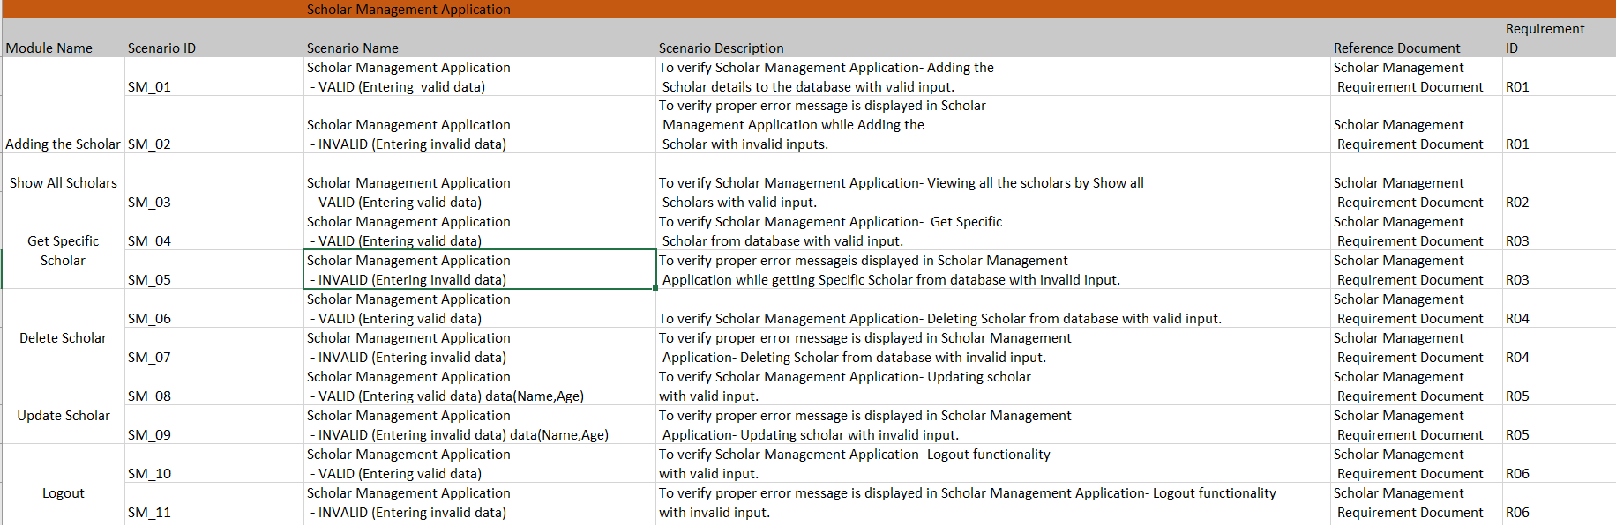
Excel View of Test Scenario

Slide 47
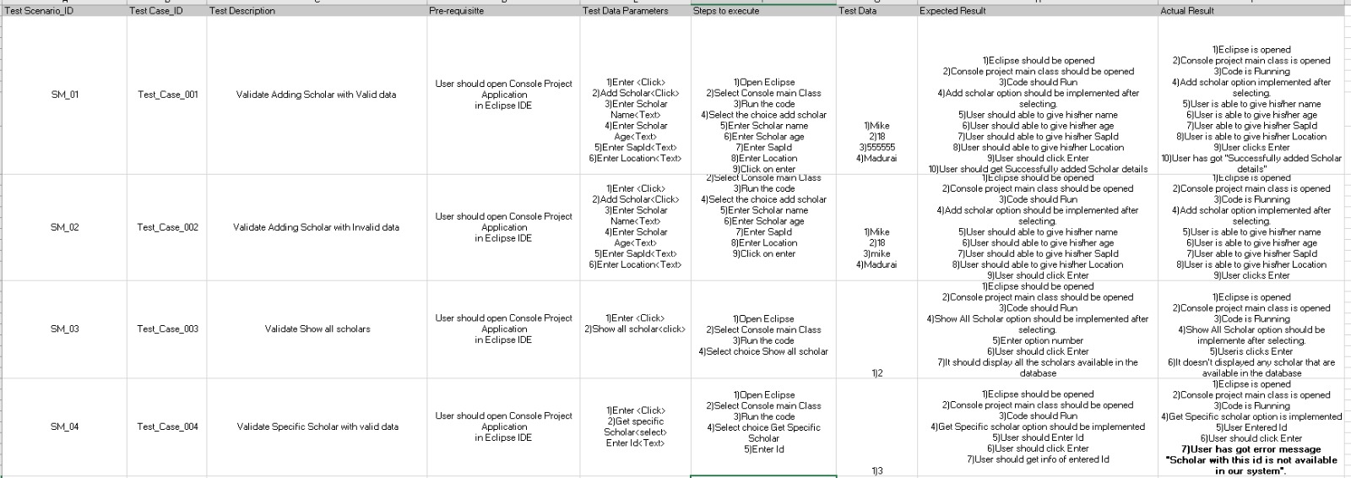
Excel View of Test Cases

Slide 48
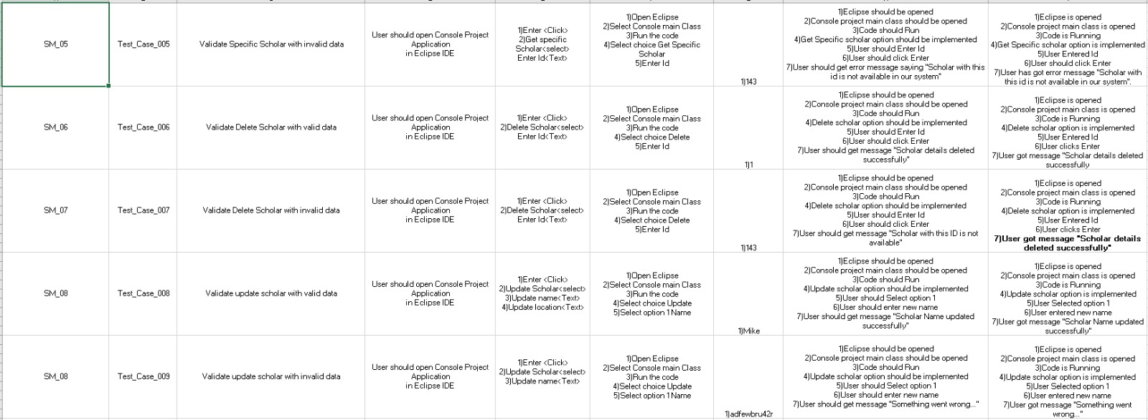
Excel View of Test Cases

Slide 49
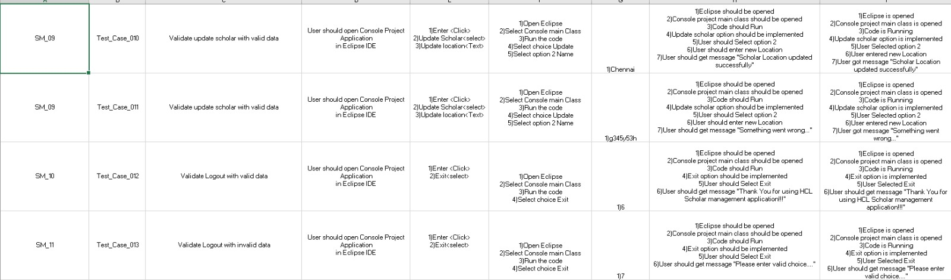
Excel View of Test Cases

Slide 50

Excel View of Defect Log

Slide 51

Excel View of Defect Log

Slide 52

Excel View of RTM

Slide 54
MODULES OF AUTOMATION TESTING
1. Signing in 2. Buy option 3. Daily deals 4. Help and contact

Slide 55
SPECIFICATIONS OF PROJECT
1. Page Object Model (POM) without Page Factory 2. Reading Data From Excel 3. Driven Testing 4. Extent Report Generations 5. TestNG Frame work

Slide 56

Source Code(Automation): Signing in module(main)

Slide 57


Source Code(Automation): Signing in module(main)

Slide 58

Source Code(Automation): Signing in module(Page object)

Slide 59

Source Code(Automation): Signing in module(Page object)

Slide 60

Extent Report: Signing in module

Slide 61

Emailable-Report: Sign in module

Slide 62

Source Code(Automation): Buy module(main)

Slide 63

Source Code(Automation): Buy module(main)

Slide 64

Source Code(Automation): Buy module(Page object)

Slide 65

Extent Report: Buy module

Slide 66

Emailable-Report: Buy module

Slide 67

Source Code(Automation): Daily Deals module(main)

Slide 68

Source Code(Automation): Daily Deals module(main)

Slide 69

Source Code(Automation): Daily Deals module(Page object)

Slide 70

Extent Report: Daily Deals module

Slide 71

Emailable-Report: Daily Deals module

Slide 72

Source Code(Automation): Help and contact module(main)

Slide 73

Source Code(Automation): Help and contact module(main)

Slide 74

Source Code(Automation): Help and contact module(Page Objects)

Slide 75

Extent Report: Help and contact module

Slide 76

Emailable-Report: Help and contact module

Slide 77

Source-code: testing.xml

Slide 78


Emailable-Report: testing.xml

Slide 79
GitHub link:
https://github.com/Surya040204/Pratice-Project.git

Slide 80
Thank you

